Slide 1
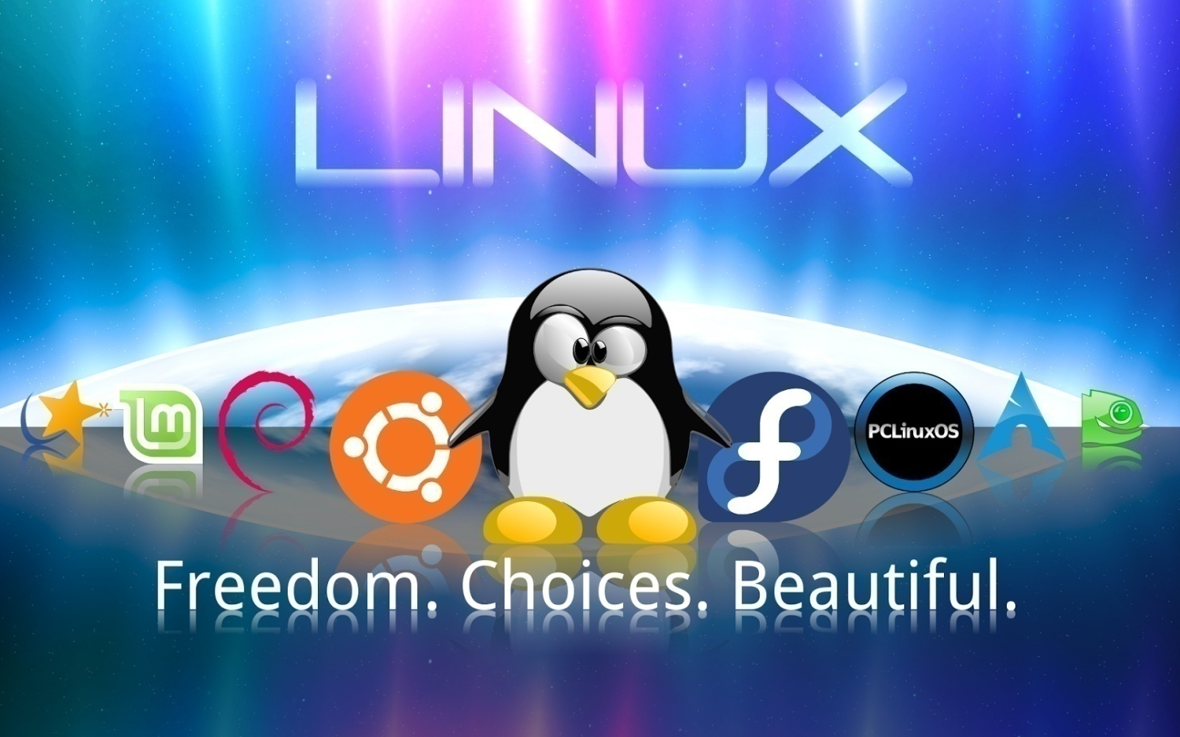
Introduction to Linux

Slide 2
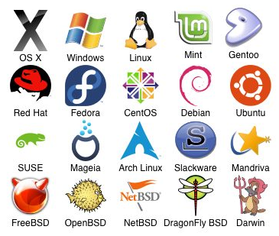
Before we learn Linux, let’s understand:
What is an Operating System?

Slide 3
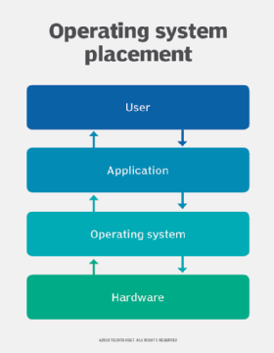
Operating System
An operating system (OS) is the program that, after being initially loaded into the computer by a boot program, manages all of the other application programs in a computer. In addition, users can interact directly with the operating system through a user interface, such as a command-line interface (CLI) or a graphical UI (GUI).

Slide 4
Example
Think of a spell checker program it may include the following sub programs
Words from document
Lowercase
Sort
Unique
Mismatch

Slide 5
UNIX
In 1969, a team of developers in the Bell Labs laboratories developed a new operating system which was
Simple and elegant.
Written in the C programming language instead of in assembly code.
The Bell Labs developers named their project "UNIX.“
Linus Torvalds used to work on the UNIX OS and thought that it needed improvements. When his suggestions were rejected by the designers of UNIX, he thought of launching an OS which will be receptive to changes, modifications suggested by its users.

Slide 6
LINUX
Linux is an operating system or a kernel which germinated as an idea in the mind of young and bright Linus Torvalds when he was a computer science student.
Linus designed a Kernel named Linux in 1991.
There is not much difference between UNIX and Linux. Linux is a clone of UNIX.

Slide 7
Three Layers of Linux
Kernel
Shell
Utilities

Slide 8
Kernel
Kernel is responsible for the communication with the hardware, and it is actually the part of the operating system that talks directly with the hardware.
All other parts that make up the operating system (graphical user interface, file management, shell, etc.) rely on the kernel.

Slide 9
Shell
Shell is a command-line interpreter or shell that provides a command line user interface for Unix-like operating systems.

Slide 10
What Is So
Good About Linux?

Slide 11
Linux powers 94% of the world’s
Supercomputers
most of the servers powering the Internet
the majority of financial trades worldwide
Linux is free
Linux has attractive features and performance
Linux is secure
Linux is an alternative for Microsoft Windows
Linux is anti-Microsoft

Slide 12
Linux Distribution
Almost six hundred Linux distributions exist.
Red Hat
Fedora
Ubutu
Mandrive
Mint
SUSE

Slide 13
Red Hat
Red Hat Enterprise Linux is a performance-driven, cost-effective platform for Microsoft SQL Server that provides a scalable foundation and a consistent application experience across bare-metal, virtual machine, container, and hybrid cloud environments.

Slide 14
Fedora
Fedora creates an innovative, free, and open source platform for hardware, clouds, and containers that enables software developers and community members to build tailored solutions for their users.

Slide 15
Ubuntu
Ubuntu comes with everything you need to run your organisation, school, home or enterprise. All the essential applications, like an office suite, browsers, email and media apps come pre-installed and thousands more games and applications are available in the Ubuntu Software Centre.

Slide 16
Mandriva
Mandriva Linux used a package manager called urpmi, which functions as a wrapper to the . rpm binaries. It is similar to apt from Debian & Ubuntu, pacman from Arch Linux, yum or dnf from Fedora in that it allows seamless installation of a given software package by automatically installing the other packages needed.

Slide 17
Mint
The purpose of Linux Mint is to provide a desktop operating system that home users and companies can use at no cost and which is as efficient, easy to use, and elegant as possible.

Slide 18
SUSE
SUSE Linux Enterprise Server is scalable and allows users to efficiently deploy IT services across a variety of environments. With SLES, users can increase system reliability, maintain security compliance and enable new technologies under one overarching operating system.

Slide 19
More than 90% of current Linux source code is written by other developers (and not Linus Torvalds himself)
Most of the Super Computer's use Linux. And the numbers are growing on a yearly basis.
Android’s Operating System is based off of Linux. There are more than 10 Linux based Mobile operating System's. Normally people think Android is the only operating system that's based on Linux. However there are more than 10 mobile operating system's based on Linux. OpenZaurus, Firefox OS, Sailfish OS, Ubuntu Touch, Ubuntu Mobile, Mobline etc are a few apart from Android.
Google has its own Linux Distribution for its internal Employees. Its called Goobuntu. Its not currently available for general public.
Steve Jobs once offered (in 2000) a job to Linus Torvalds at Apple but Linus rejected the offer.

Slide 20
For those who think Linux can’t do Animation – Oscar-winning visual effects of the Titanic by James Cameron came from machines with Linux and Avatar was the last movie completely developed in 3D Applications on Linux platform using Foss Software.
Top ten of supercomputers use Linux. 33.8% of the world runs on Linux servers compared to 7.3% running Microsoft Windows operating system.
Server hosting the website: Google, Cisco, Facebook, Twitter, Linked in

